Slide 1
Japan Attraction Review
TRIPADVISOR – Text mining and Sentiment Analysis
LOW KANG JIANG (E0146478)
HUANG FUXING (E0147025)
TAN HUI XIN (E0146437)
TEY PENG MOK (E0146914)
ZHANG HUAI PENG (E0147003)

Slide 2
Overview
Introduction
Objectives
Schema Design
Data Crawling
Analytics
Data Backup and Data Restore

Slide 3


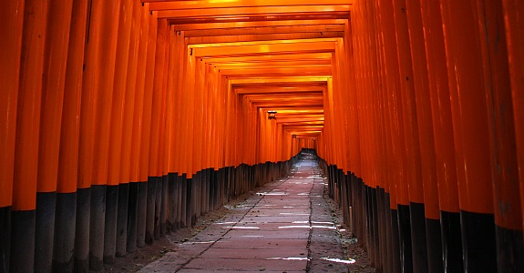
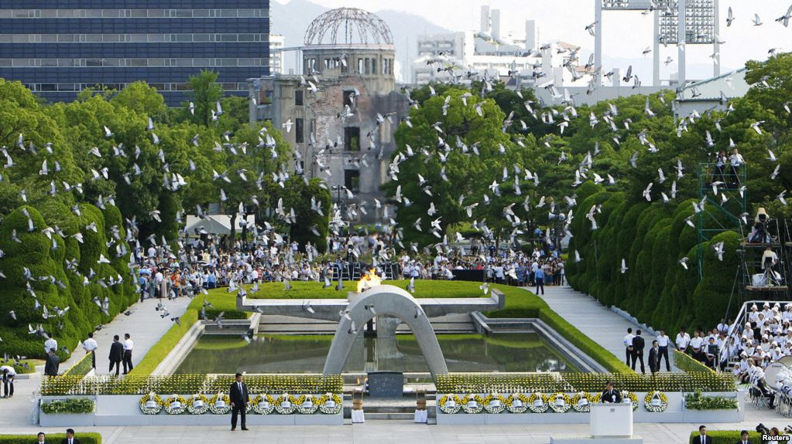
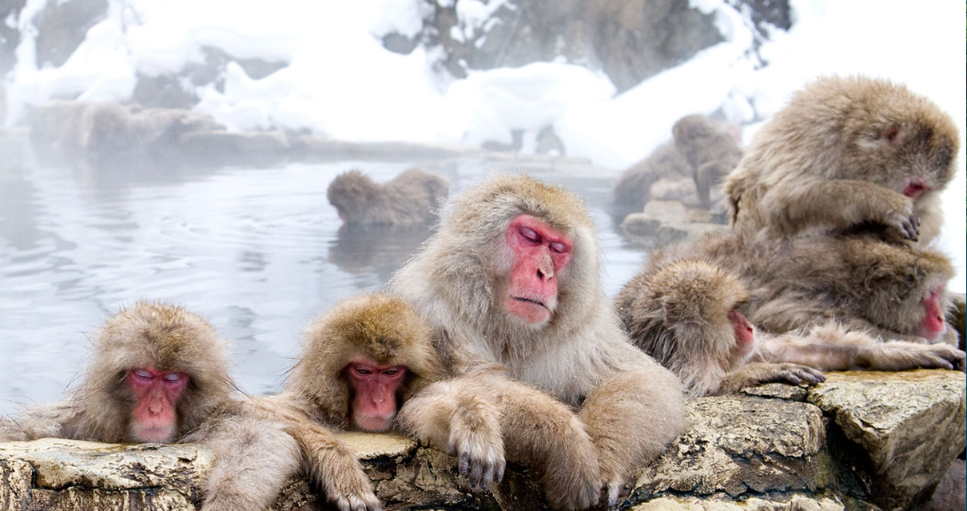

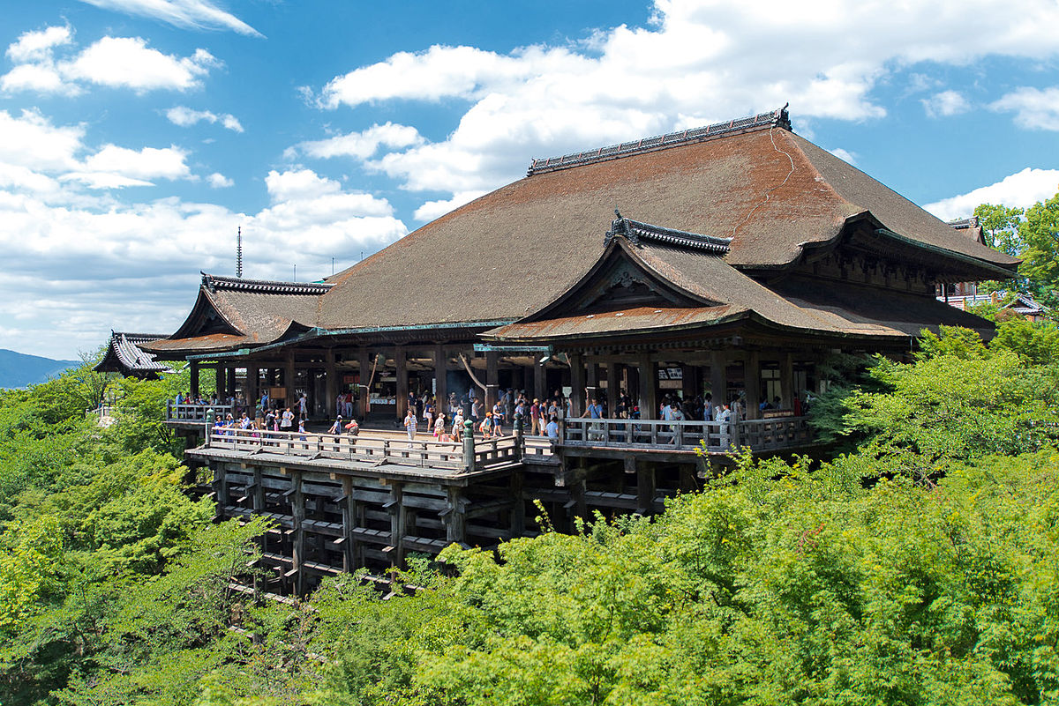
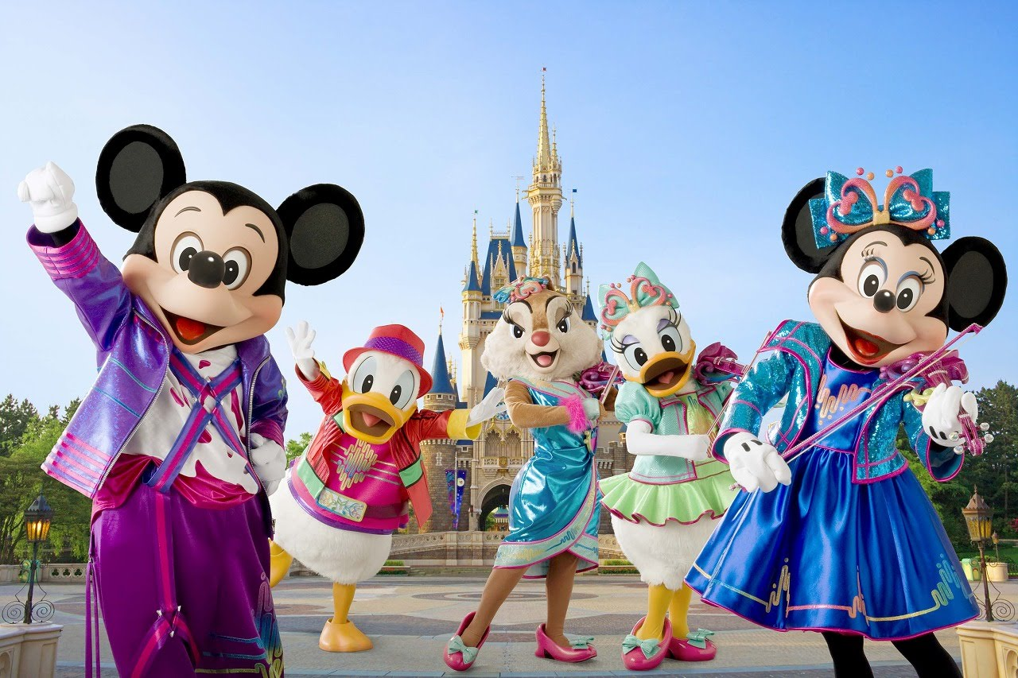
introduction
Text Mining
Fushimi Inari Park
Hiroshima Memorial Peace Park
Jigokudani Snow Monkey Park
Sentiment
Analysis
Kiyomizu Dera
Tokyo Disneyland

Slide 4




objective
CHALLENGES
OBJECTIVES
HOW WE DO IT?
Which one I should visit?
TripAdvisor has thousands of reviews submitted on their portal.
Reading reviews one-by-one is a hassle and it will take a lot of time to distinguish positive and negative reviews.
To provide an easy visual of each attractions plus and minus points based on reviews submitted
To figure out the crucial factors that will affect traveler’s satisfactions of the services provided by various attractions in Japan.
Text mining on the reviews and extract the key terms to construct a word cloud.
Sentiment analysis to calculate sentiment polarity score for each of the reviews.

Slide 5
Schema design
Key Features
Scheme design allow analyst to conduct text mining or sentiment analysis on both attractions level (across different comments collection) and reviewers level (across different reviewers document)
Comments collection can grow unbounded whereas there is only one reviewers collection with clear naming

Slide 6
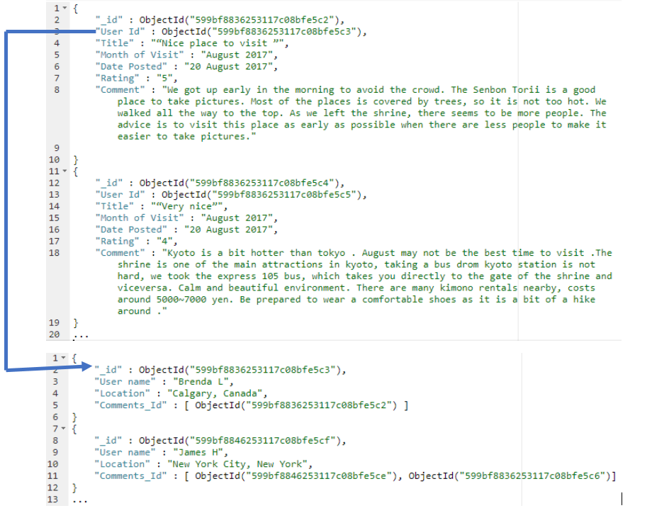
Schema design Referenced One-to-One Relationship from Comments to Reviewers
Feature
Each of the document in comments collection can be referred to one reviewer in the reviewers collection using the stored User Id as a reference key
Reasons
Need to frequently extract the review content related info but NOT so for the reviewer related info
Conduct sentiment analysis on a reviewer all the comments submitted for different attraction
Use Cases
Text mining and sentiment analysis on Title or Comment
Rating used to calculate the correlation between sentiment polarity score and rating
Month of Visit and Date Posted allow analyst to select documents within a period to conduct the analysis

Slide 7
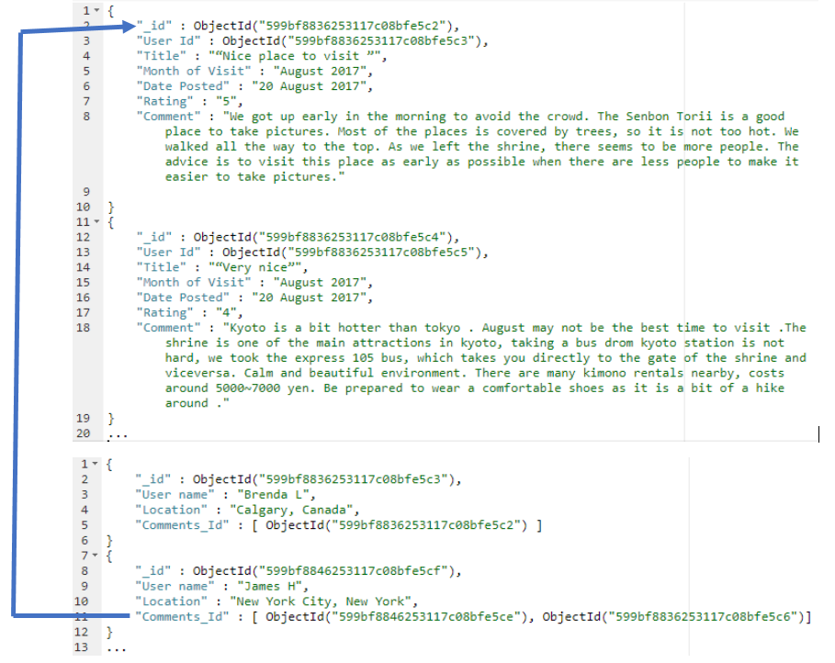
Schema design Referenced & Embedded One-to-Many Relationship from Reviewers to Comments
Feature
Comments_id for each document in reviewers collection can map the reviewers back to their comment in comments_at_+attraction collection
Reasons for Comments_id Referenced
Used of reference Comments_id in each of the reviewer document ensure that the comments do not have repetition storage
Reasons for Embedded Comments_id
Analysts frequently retrieve ALL the comments that reviewer submitted to conduct analysis

Slide 8
Schema design Reviewers Collection Mutable Array Problem Consideration
Consideration
Number of attraction to be analyzed in the future increase and hence increase the number of comments stored in database, the comment_id of reviewers document may grow inevitably
Reason to stay with original design
Number of comments per reviewer is small
The storage using comment_id does not consume a lot of memory
Carried more business value to conduct sentiment analysis for EACH reviewer based on their base location in the future

Slide 9
Data crawling
Define
Extract
Store
Analysis
Web HTML
div/
span/
class
Field Value Pair
Mongo
DB
Analytics Output
Define the period of extraction
Define the list of attraction with seed url
Define a library for data storage
Create a loop to go through each review page
Convert to HTML to parser tree format using BeautifulSoup
Extract the reviews related data from associate html heading
Store the extracted data in as document in collection according to the designed schema
Conduct Text Mining and Sentiment Analysis on the store collection document

Slide 10
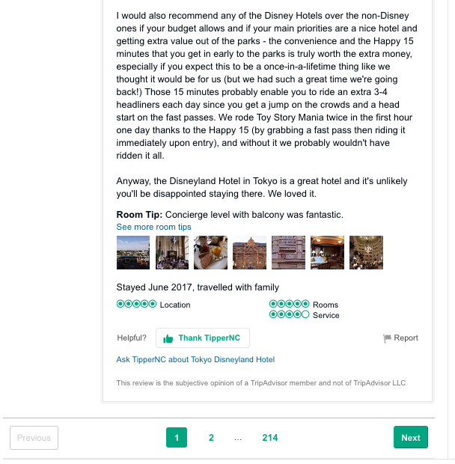
Data crawling design and extract
Design
The period of extraction : 365 days
Create a list to store the seed url for each attraction review
Define a flexible and scalable variable for period of reviews extracted and attractions of interest depending on the business requirement
Extract
A loop to go through each review page, as reviews span across many pages
We locate the next url heading from the html file and use it to update the url at the end of each scraping cycle until the one year period reviews condition was met, thus allowing us to collect all the reviews over a one-year period

Slide 11
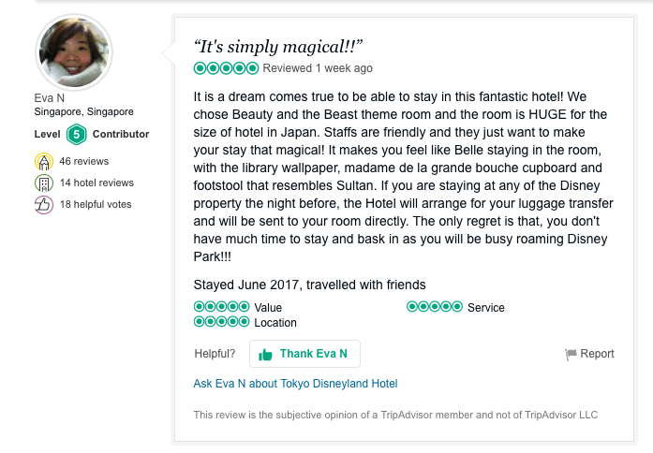
Data crawling extract reviews
Username and Location: From class “member_info”
Use a condition check to detect missing value fields and assigned anonymous and unavailable tag for User Name and Location fields in the reviewers collection accordingly
Title: From class “quote”
Comment: From header “p”
Month of Visit: From class “recommend-titleInline noRatings”
2
1
3
4

Slide 12
Data crawling extract
Rating: From class “rating reviewItemInline”
Stored as “ui_bubble_rating bubble_x0” where x represent the integer value of the rating. Extracted string x and stored it as integer value.
Date Posted:
Variable for condition check of period of extraction
Html class heading that store the data changed from “ratingDate relativeDate” to “ratingDate” when the review is older than a certain period.
Condition check required
4
5

Slide 13





analytics text mining procedure
1
2
3
4
5
Concatenate all the review into one huge text file
Convert all the text into lower case for normalization
Remove non-English words, punctuation and stop words
Create a new word list for adjective, noun and verb
Generate a word cloud using the process text list
Generate the top 5 double word phrase

Slide 14
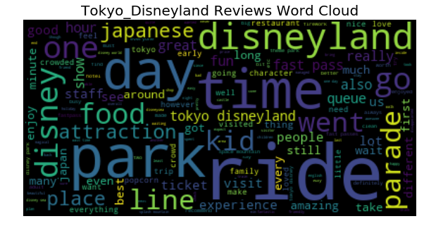
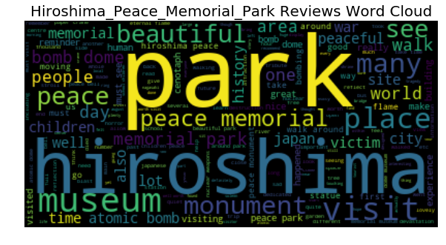
analytics Word cloud
Tokyo Disneyland Review Word Cloud
Hiroshima Peace Memorial Park Review Word Cloud

Slide 15
analytics text mining
Attractions | Rating Distributions | Top 5 double words phrase | Top 5 double words phrase with Rating 5 | Top 5 Common Word
Fushimi Inari Shrine | 1 star: 8 2 stars: 21 3 stars: 142 4 stars: 729 5 stars: 1885 | Oinari San Tofu Steak Mosquito Repellant Public Transportation Faint Heated | Oinari San Tofu Steak Mosquito Repellant Public Transportation Faint Heated | Shrine Gates Kyoto Top Walk
Tokyo Disneyland | 1 star: 18 2 stars: 16 3 stars: 33 4 stars: 148 5 stars: 310 | Donald Duck Crystal Palace Astro Blasters Indiana Jones Universal Studio | Crystal Palace Ice Cream Indiana Jones Toon Town Peter Pan | Disneyland Disney Rides Park Time

Slide 16


analytics sentiment analysis procedure
1
2
3
4
5
Convert all the text into lower case for normalization
Remove non-English words, punctuation and stop words
Calculate the Sentiment Polarity Score for each sentiment
Search for top 3 positive sentiment comment
Calculate the correlation between the sentiment score and review rating
Search for top 3 negative sentiment comment

Slide 17
analytics sentiment mining
Attractions
1st Most Positive Sentiment Review
2nd Most Positive Sentiment Review
“The memorial park is a must if you are visiting the museum or the dome. It has been put together beautifully to allow you to remember those impacted and reflect on the impact of the a-bomb.”
“It's solemn and a good place to contemplate. Autumn is the best time to visit, seeing reds and yellows in the area. Afterwards you can visit the shopping street - Hondori, it's just walking distance from the park.”
Hiroshima Memorial Peace Park
“This is my fifth time in Tokyo Disneyland. And it is always a place that will bring out the child in everyone. I think Springtime is the best time to go to Tokyo.”
“If you are visiting Tokyo, don't miss the Disneyland. It's a happy place for everyone! Staff are nice, rides are awesome!”
Tokyo Disneyland

Slide 18
analytics sentiment mining
Attractions
1st Most Negative Sentiment Review
2nd Most Negative Sentiment Review
“Going around this park gave me goosebumps. To think this was totally devastated during WWII. Praying that such horrifying event will never happen again!”
“It is part of the peace complex which includes the museum, the park, the A-bomb dome and the cenotaph.”
Hiroshima Memorial Peace Park
“Terrible experience wait 2 hours for every attraction! Then lunch time you wait for over an hour for chicken nuggets, to find out you cant get a seat! The food is horrible on top of that..... honestly I don't understand why people go here. Sat on the stage but got kicked off, so ate standing up. I recommend you spare yourself and your kids from this horror!”
“Visited with our 2 kids today, 28 December. Terrible. Queues were ridiculous. We only got 3 rides in. Even queues for popcorn were 30 minutes. There were clearly too many people in the park. Very disappointed with Disney who are clearly prioritising revenue over customer service. Avoid”
Tokyo Disneyland

Slide 19
Maintenance Data Backup and Data Restore
1
2
3
First we need establish the connection between python script and mongodb server. Import MongoClient class which will be used to communicate with the running backend mongodb server. Use the following code to do so:
from pymongo import MongoClient
Construct the connection between python script and mongodb server using the default host (localhost) and port (27017). You can also specify the remote host (IP address) and customised port using:
client = MongoClient('localhost', 27017)
Access the database within mongo server. We use the database named ‘tripAdvisor’ to store all the data captured from website ‘tripAdvisor’. Once you have a connected instance of MongoClient, you can access any of the databases within that Mongo server. To specify which database you actually want to use after the connected instance are constructed , you can access it as an attribute:
db = client.tripAdvisor

Slide 20
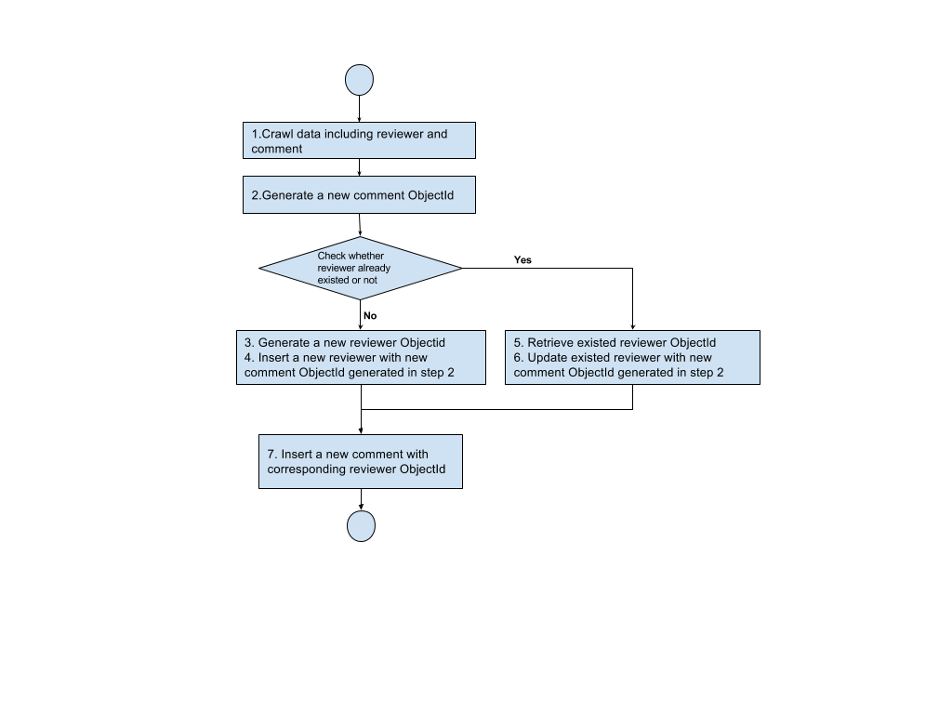
Maintenance Data Backup and Data Restore
After access the database ‘’tripAdvisor’ in mongodb server,we can insert documents into different collections by following code:
db[‘collection_name’].insert( object )
The above code can directly insert a python object into mongodb without care about of json format. The following flowchart show inserting operation

Slide 21
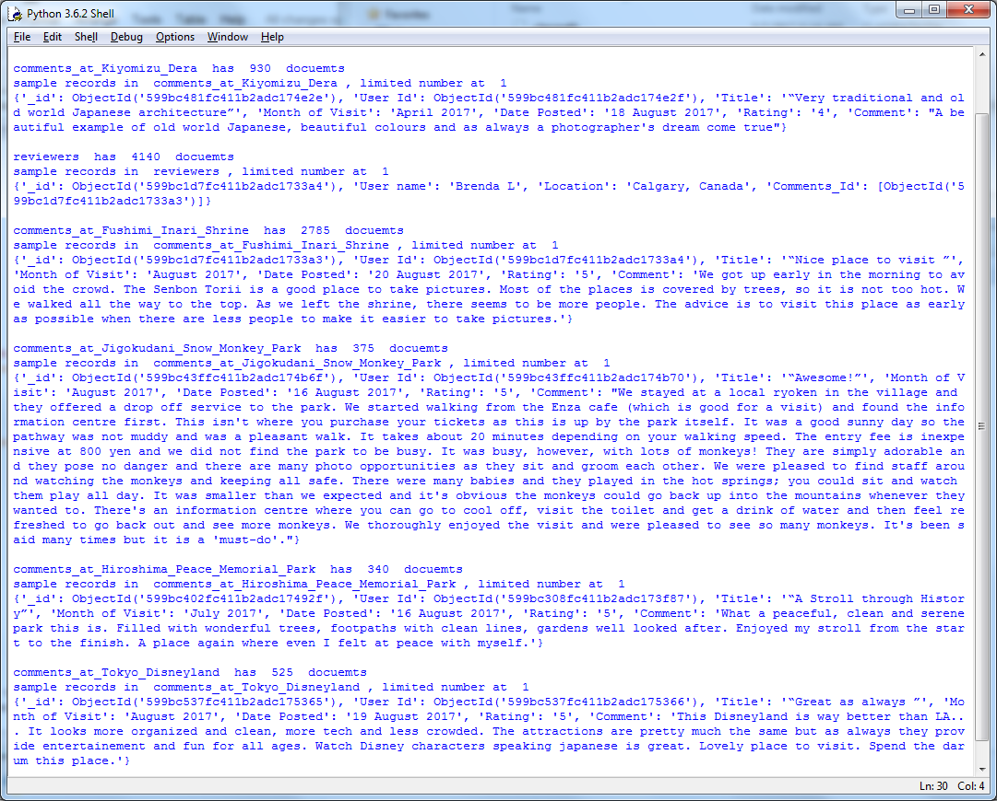
Maintenance Data Backup and Data Restore
After inserting crawling data into the database ‘’tripAdvisor’ in mongodb server,we can retrieve documents from different collections by following code:
db[‘collection_name’].find({})
The above code can directly retrieve all the documents in one collection named as ‘collection_name’. The example retrieving result as following:

Slide 22
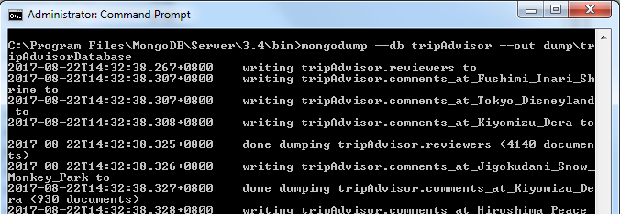
Maintenance Data Backup and Data Restore
Just type following command in the console, the dumped file will be generated in the folder ‘dump\tripAdvisorDatabase’:
Mongodump --db tripAdvisor --out dump\tripAdvisorDatabase
The dump operation as following:

Slide 23
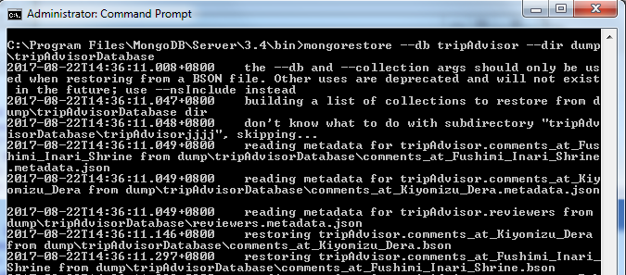
Maintenance Data Backup and Data Restore
Restore the backup data through its one of the utility tools called mongorestore which in turn is a command as well. Just type following command :
Mongorestore --db tripAdvisor --dir dump\tripAdvisorDatabase
The restore operation as following:

Slide 24


Slide 25


